Slide 1


Slide 2


Slide 3


Slide 4


Slide 5


Slide 6


Slide 7
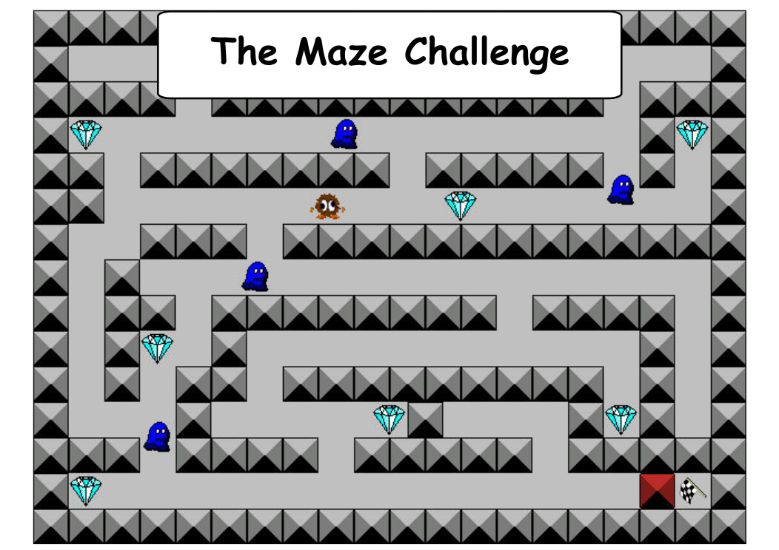

Slide 8
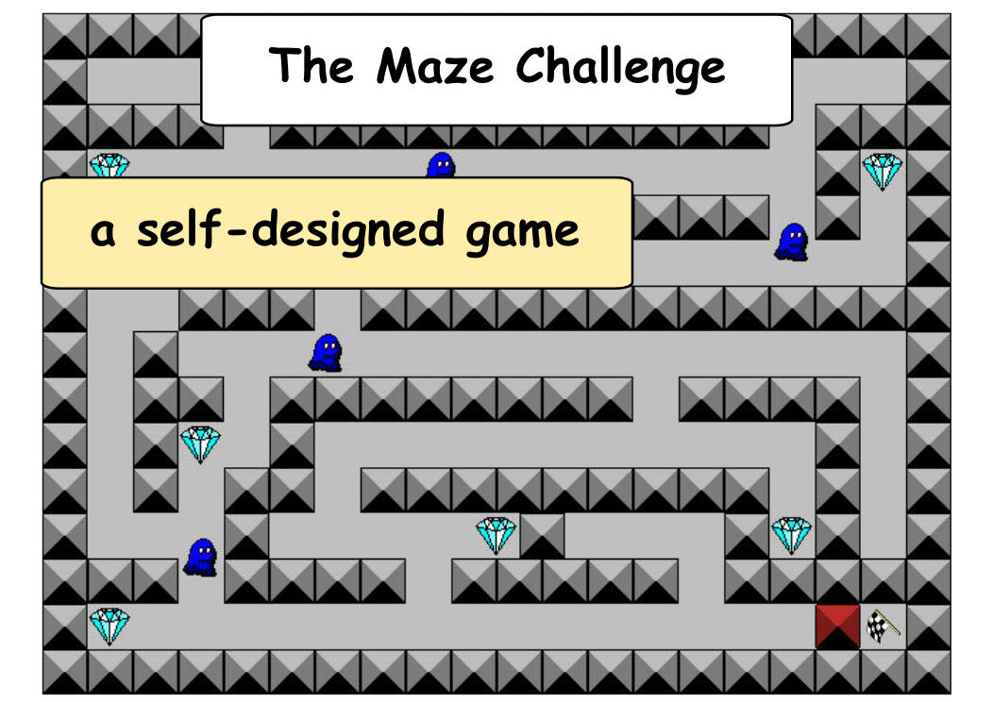

Slide 9
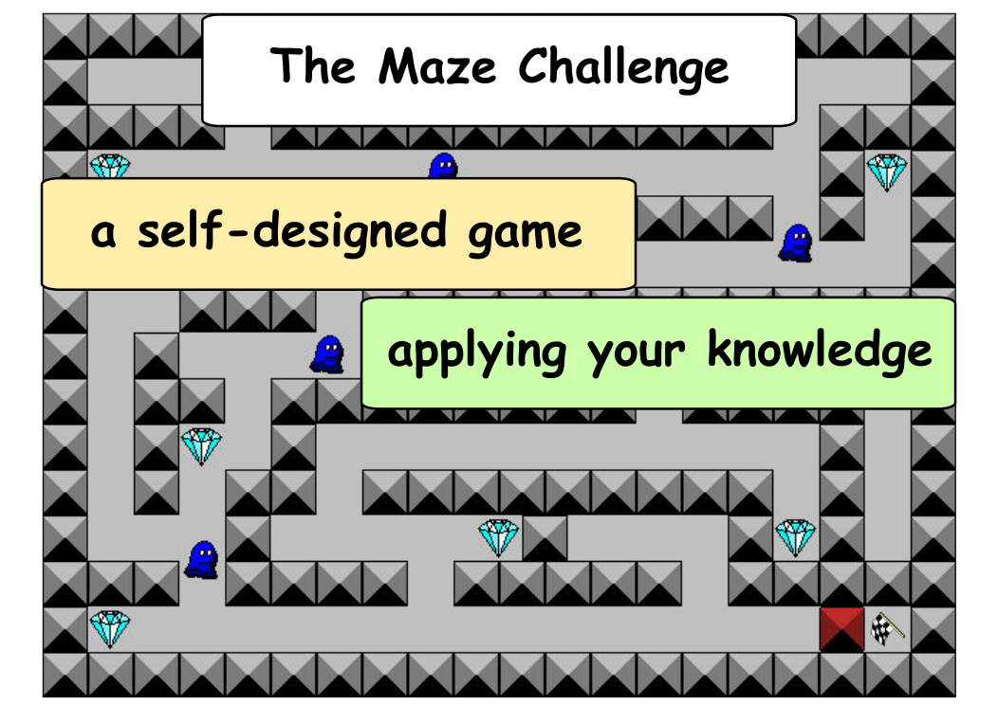

Slide 10
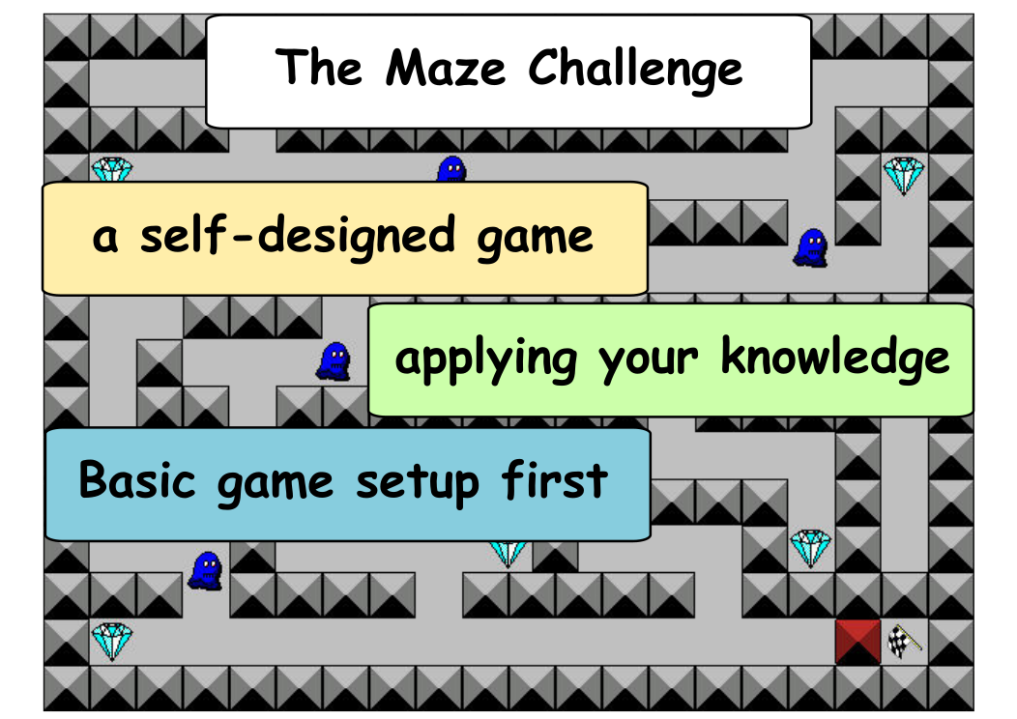

Slide 11
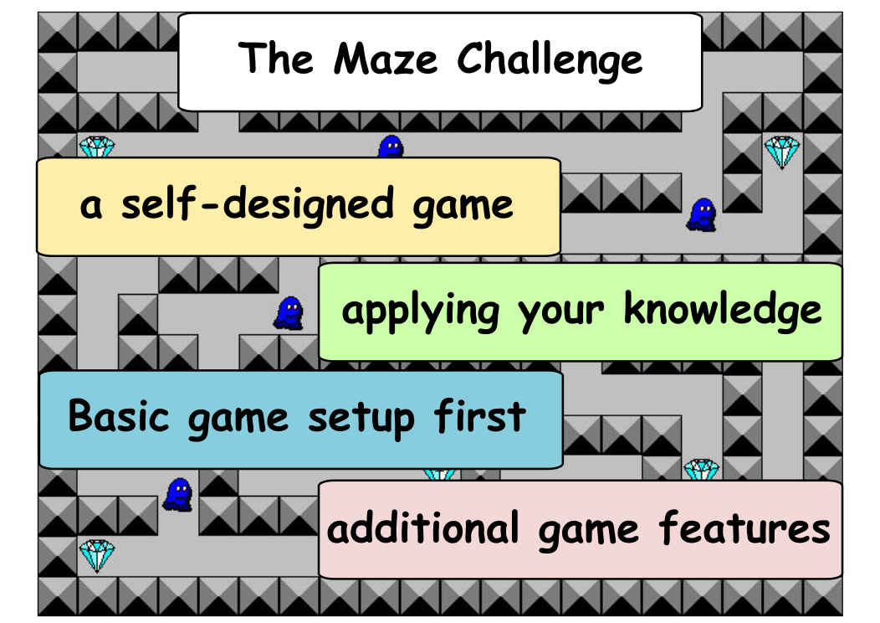

Slide 12

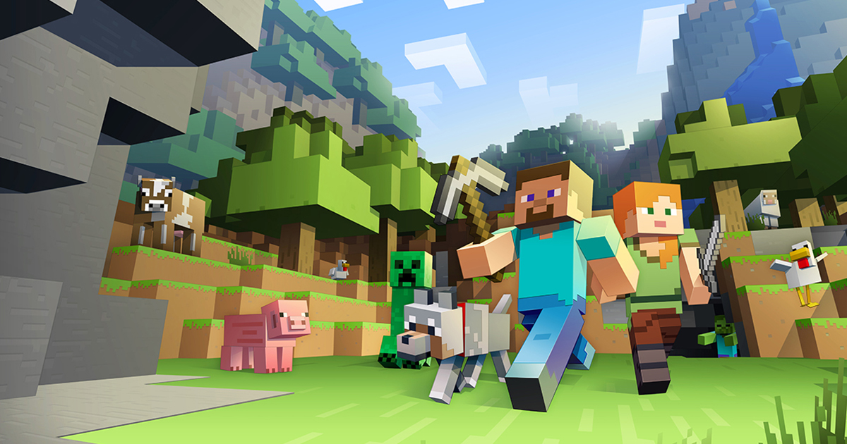

Slide 13


Slide 14


Slide 15
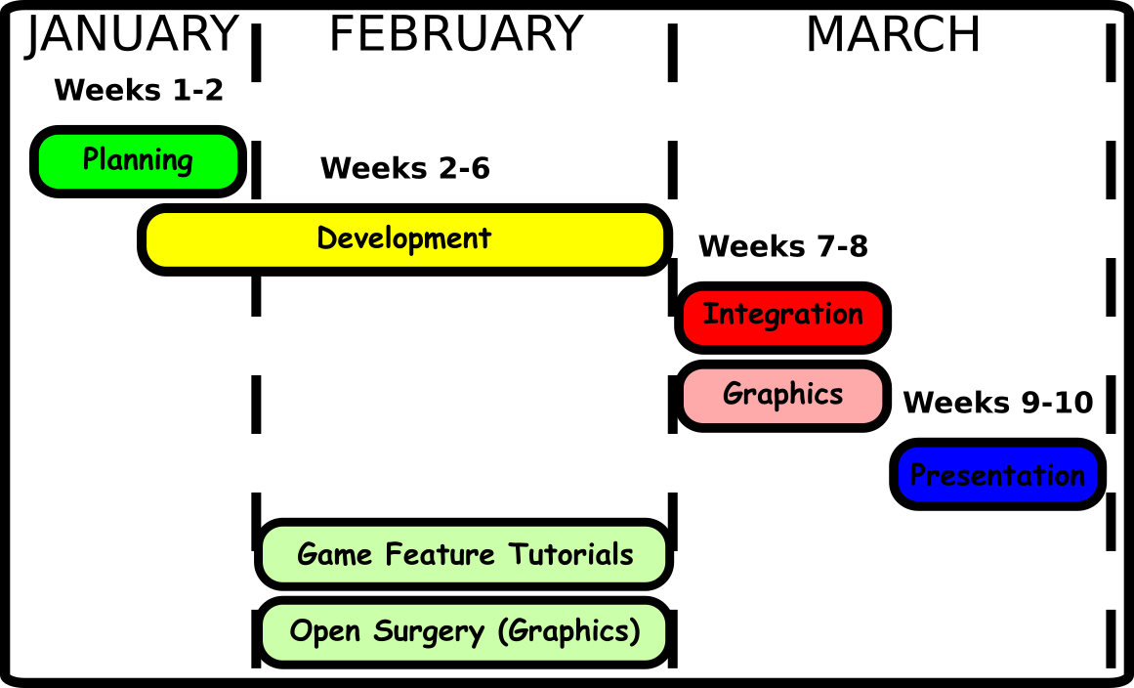

Slide 16
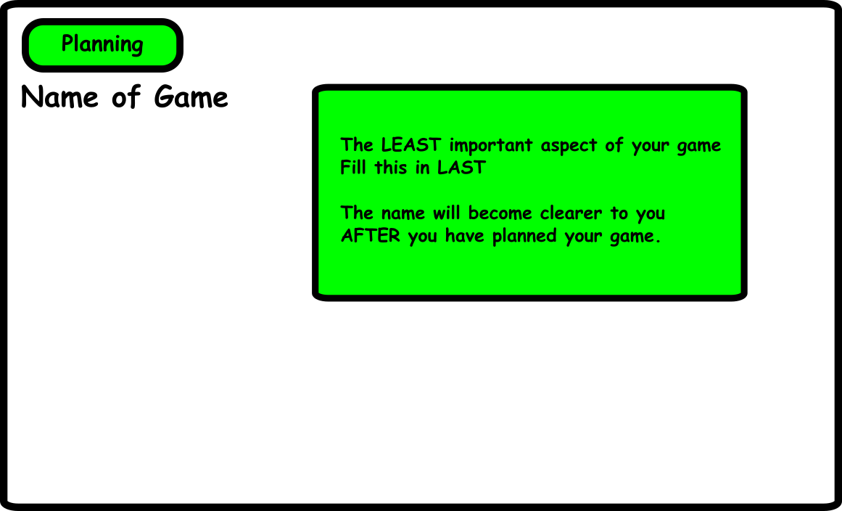

Slide 17
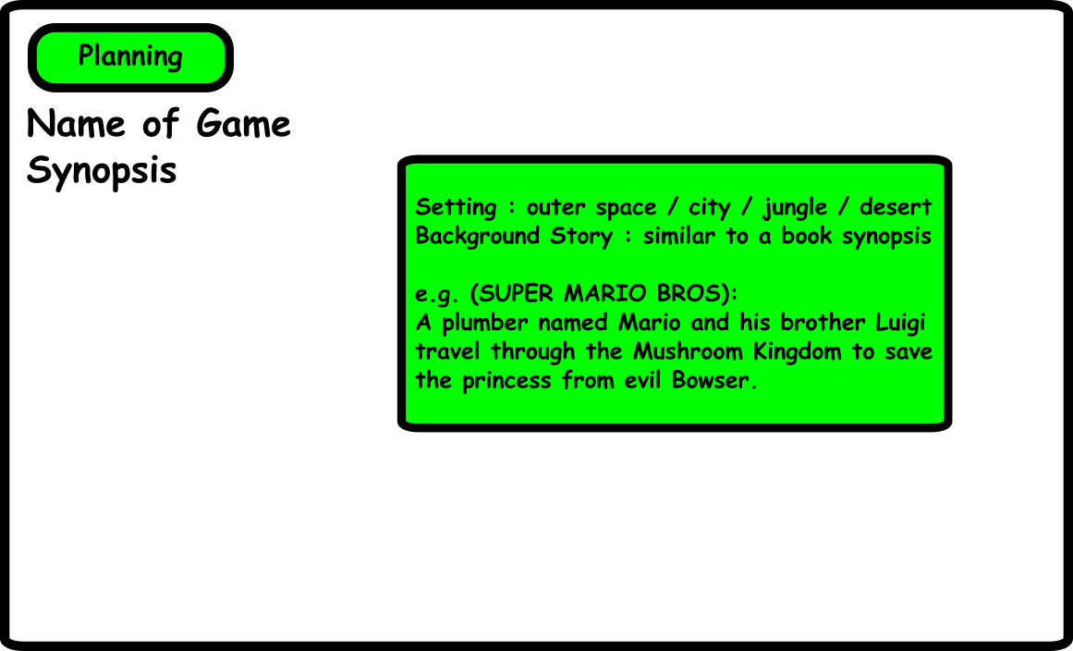

Slide 18





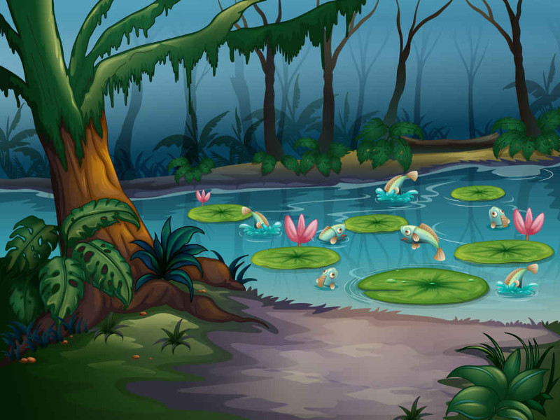




Slide 19


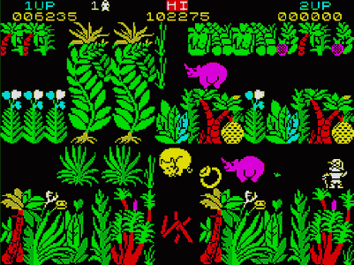
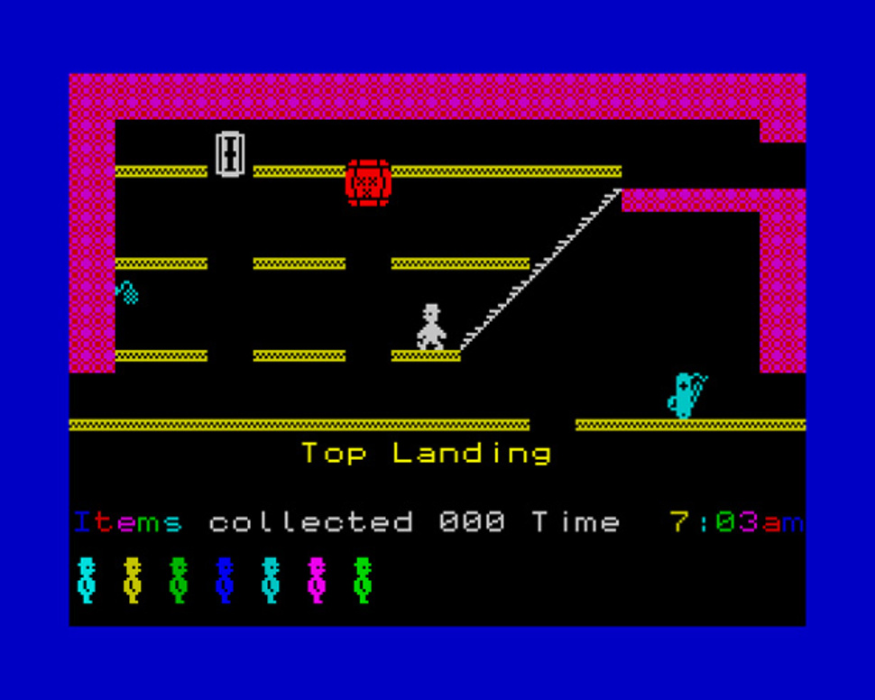

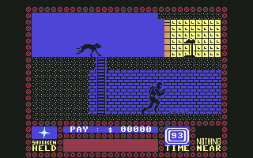
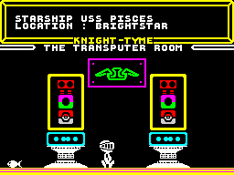



Slide 20
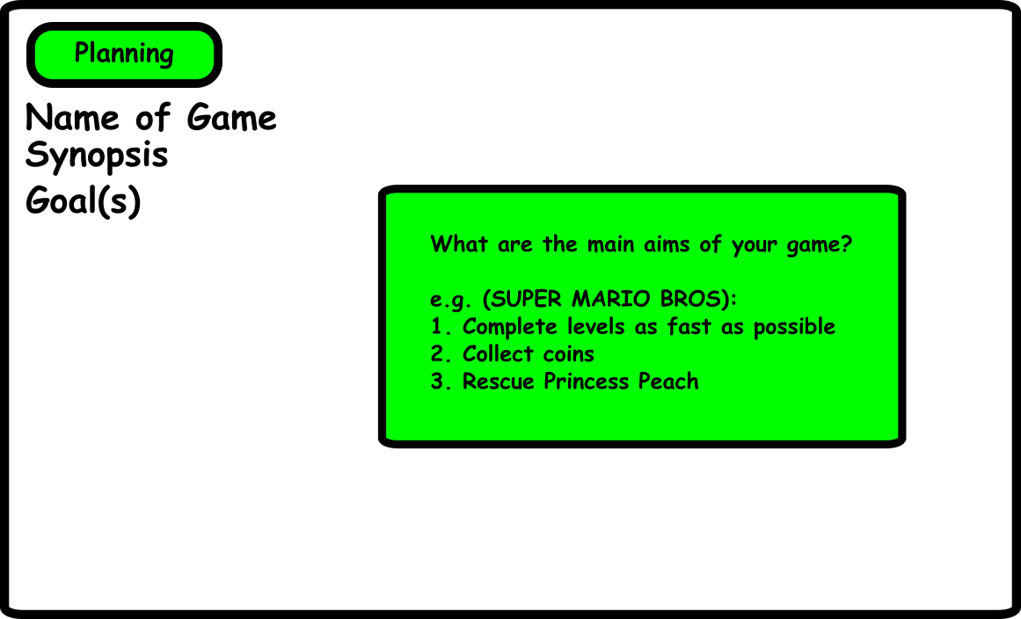

Slide 21
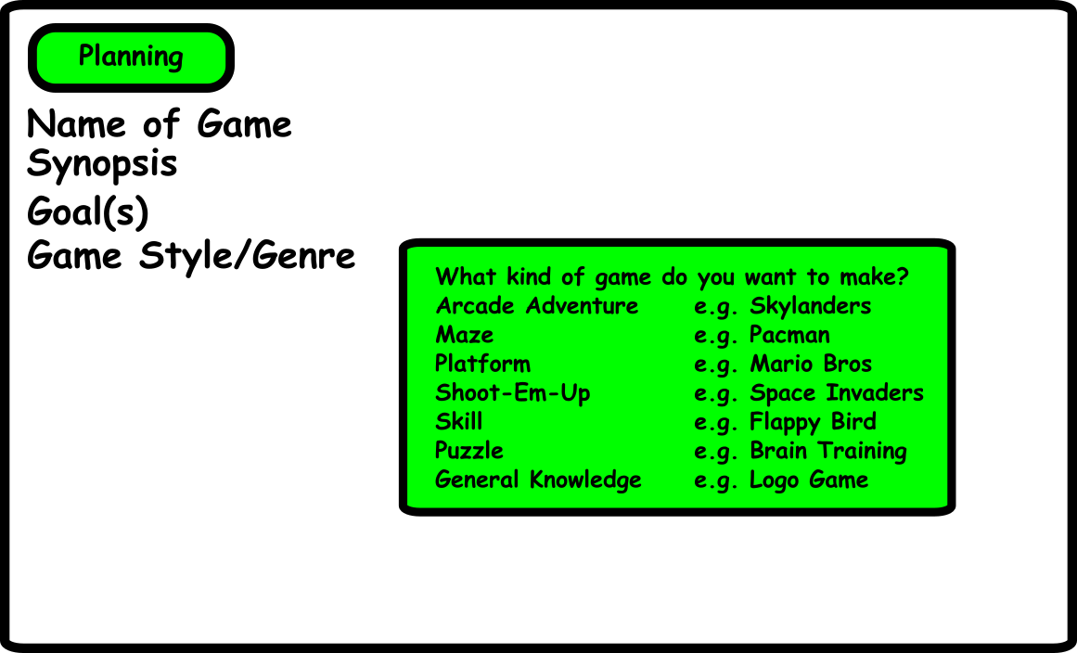

Slide 22
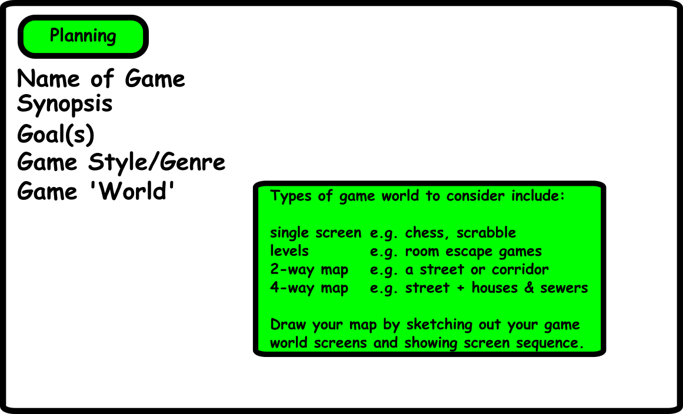

Slide 23
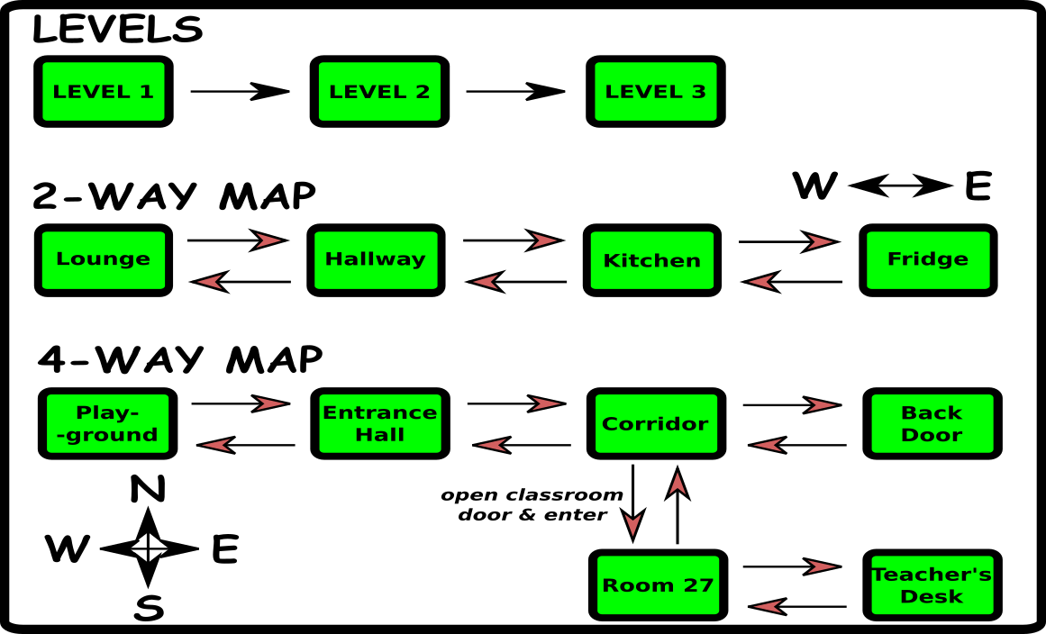

Slide 24
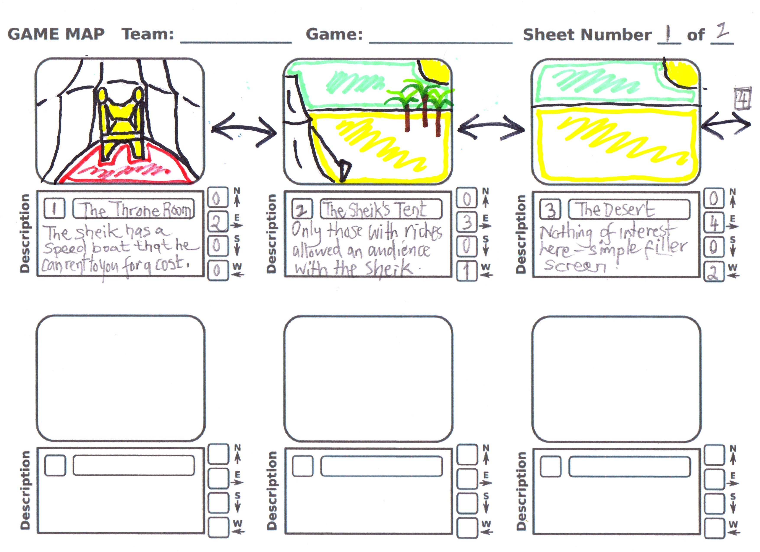

Slide 25
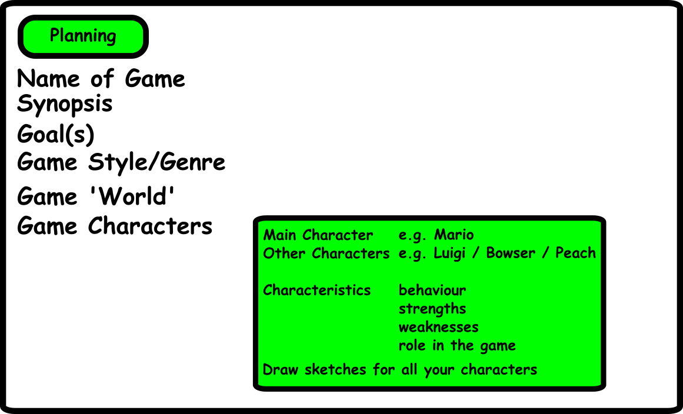

Slide 26
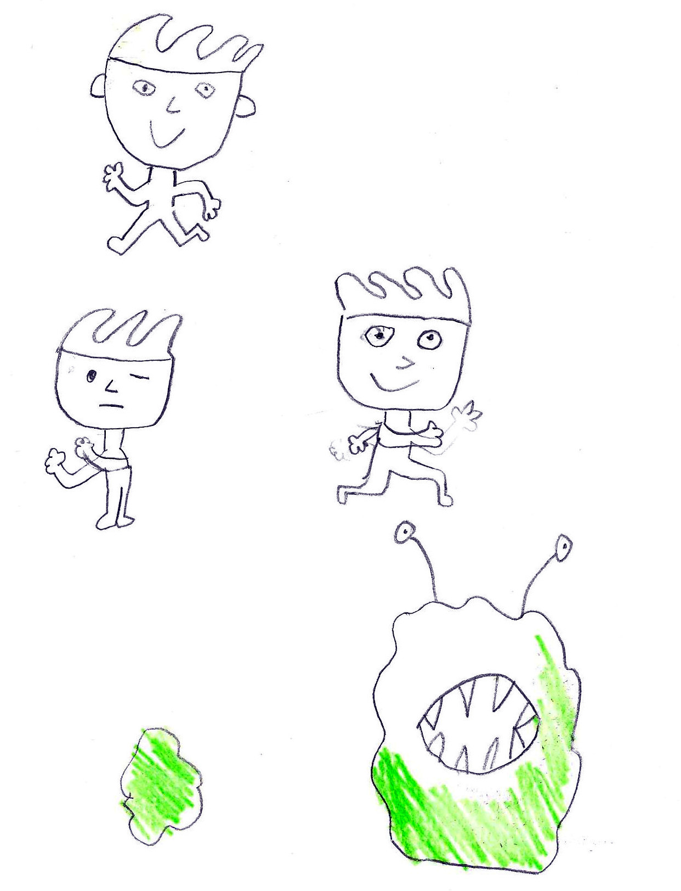
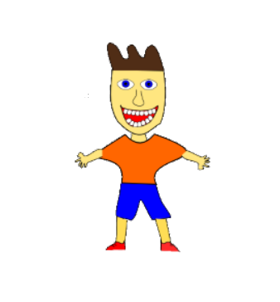


Slide 27
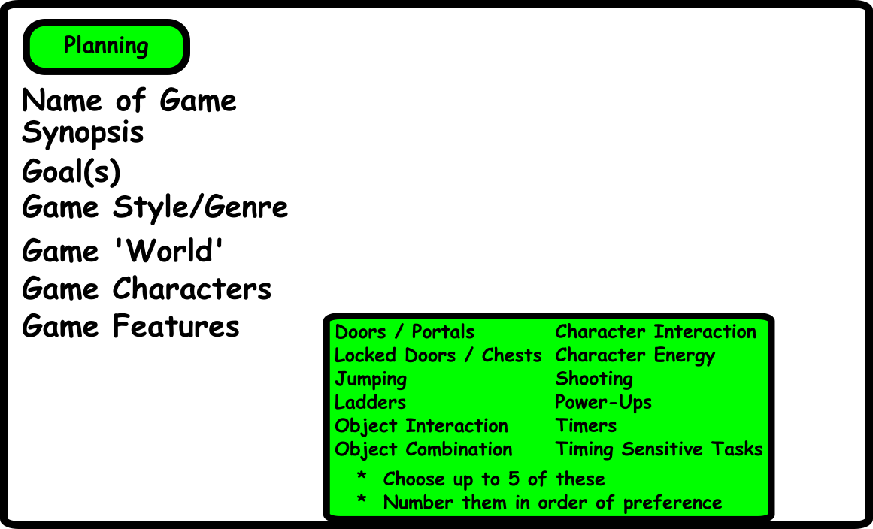

Slide 28
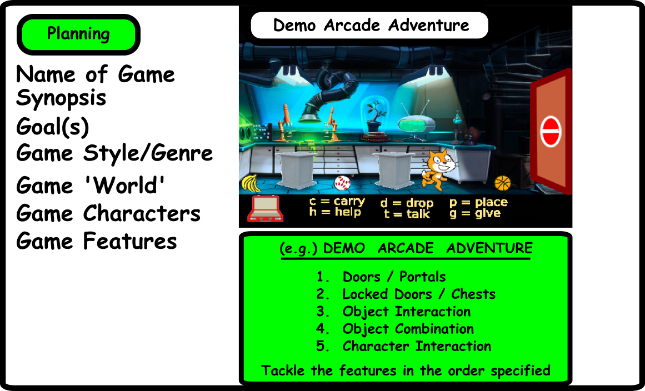

Slide 29
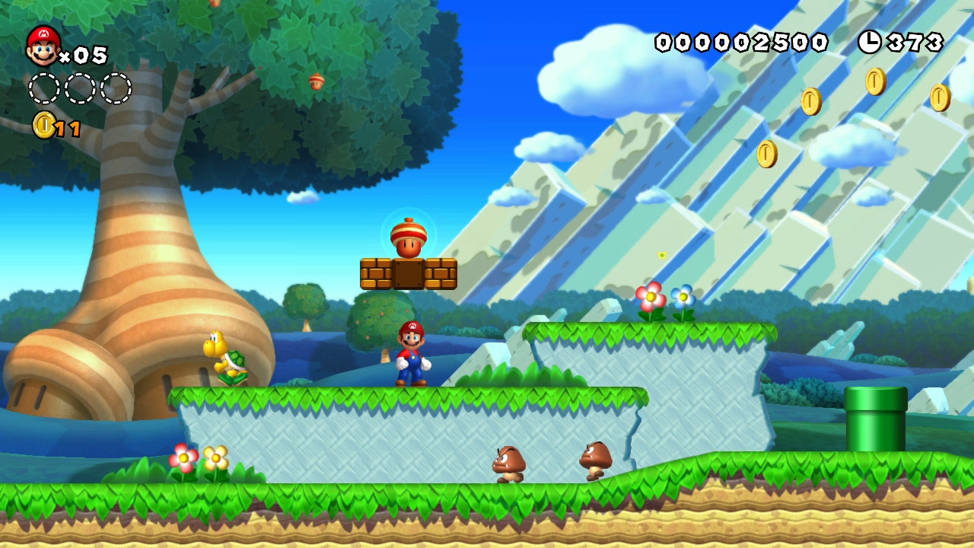

Slide 30
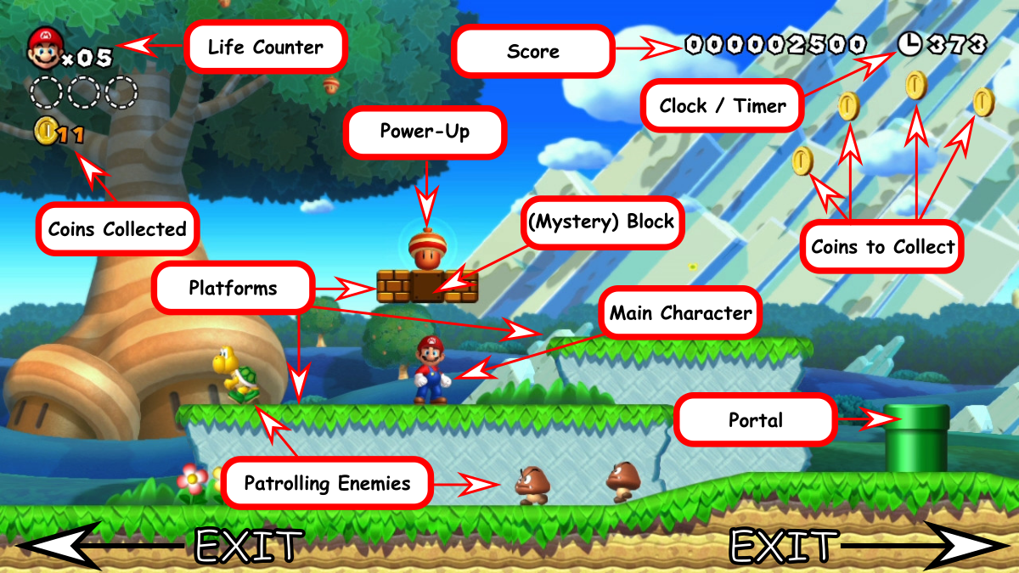

Slide 31
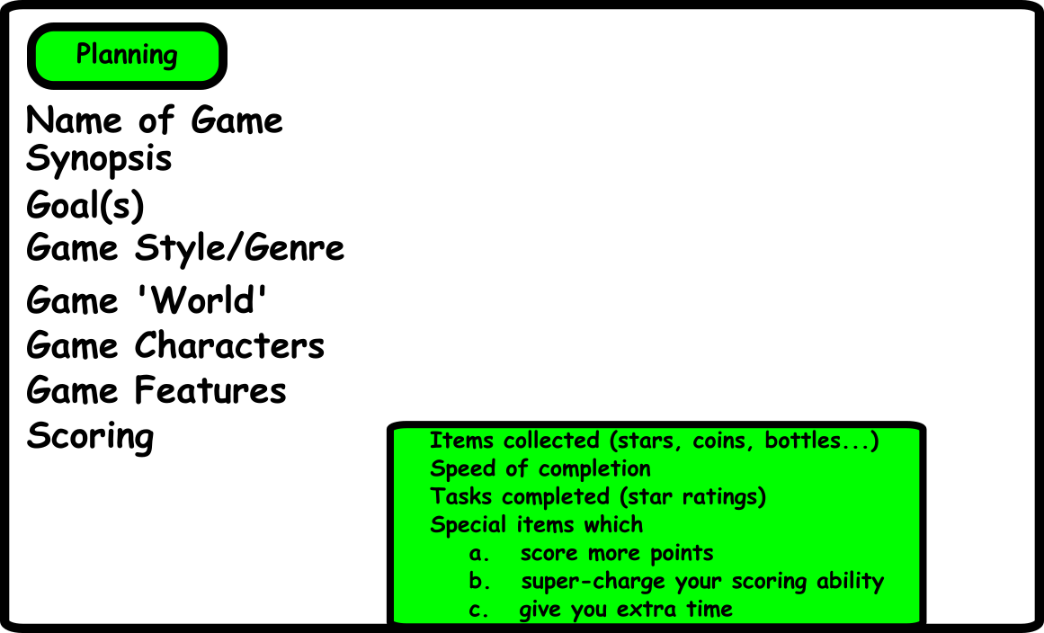

Slide 32
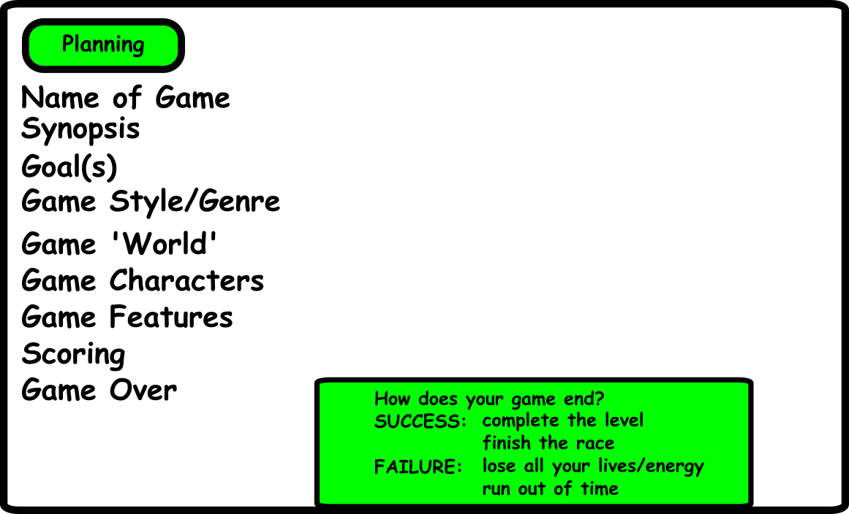

Slide 33
Development (4-5 Weeks)
Share the tasks across the team
Many ways to divide up the work
Start with library graphics
Gameplay more important than graphics
Stage Club week?

Slide 34
Integration (2 Weeks)
Start with one person's code
Import everyone else's code into this...
...one team-mate's code at a time
Fix issues b4 moving to next person's code
When you are not involved in integration...
...develop new game graphics

Slide 35
Presentation (2 Weeks)
Week 1: presentation planning/writing
Week 2: presentation day
Vote (Eurovision Style)
PRIZES!!!!!

Slide 36
What if we don't finish...
No problemo!
ALL effort is valuable
Present whatever you have
  design plans & drawings
  individual parts
  any graphics made
  discuss problems – seek advice from the room
YOU MAY STILL WIN THE VOTE!

Slide 37
Rules
Co-operation
Teamwork
Listening (to mentors)
ENJOY YOURSELF

Slide 38


